Slide 1
Database Application Project
By Mohammed Nazib Uddin

Slide 2
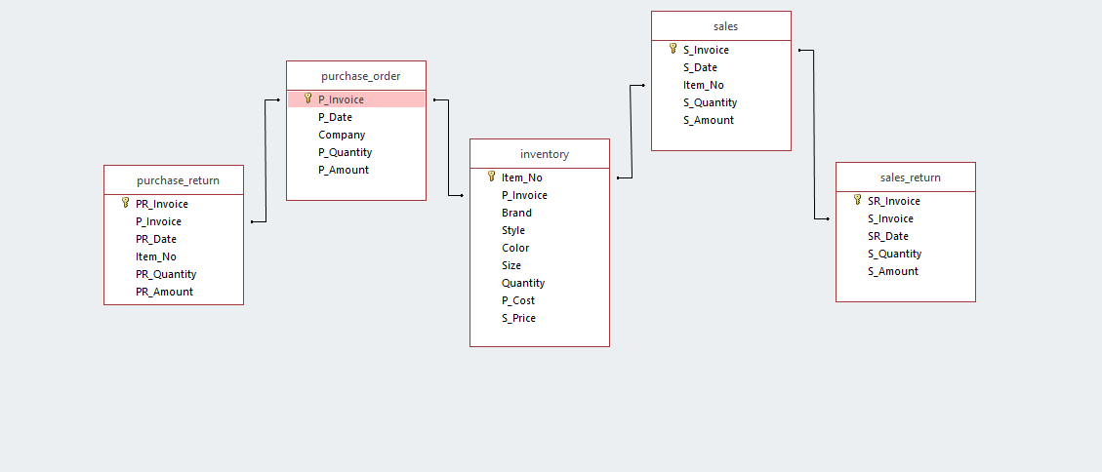
Table Structure
------PK
--------FK
------PK
------PK
------PK
------FK
------PK
--------FK
--------FK

Slide 3
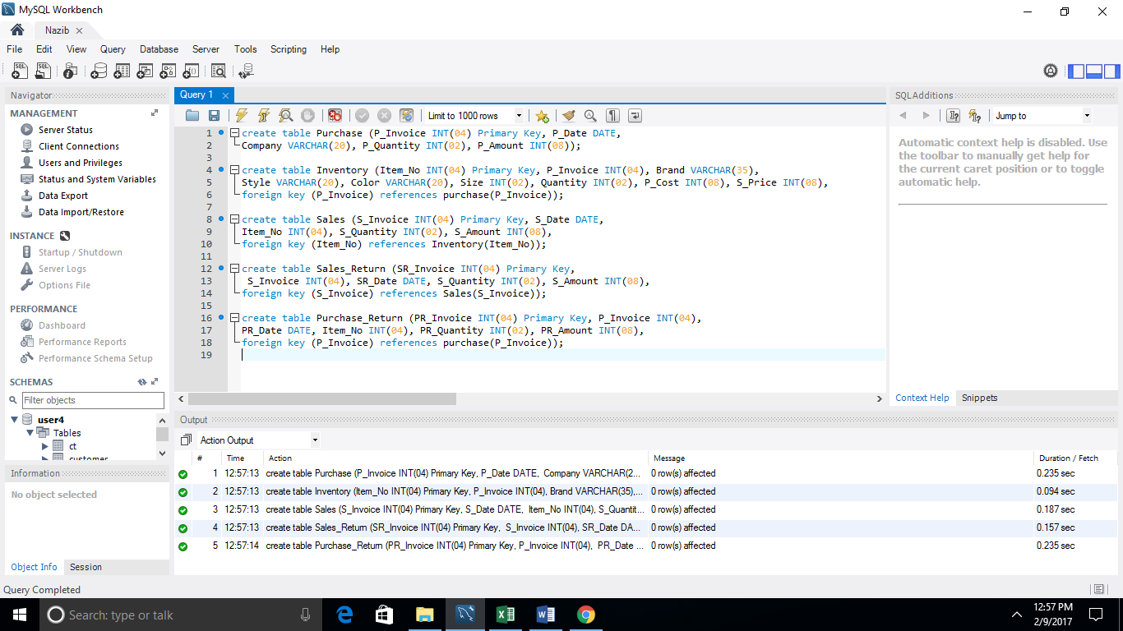
Creating Tables

Slide 4
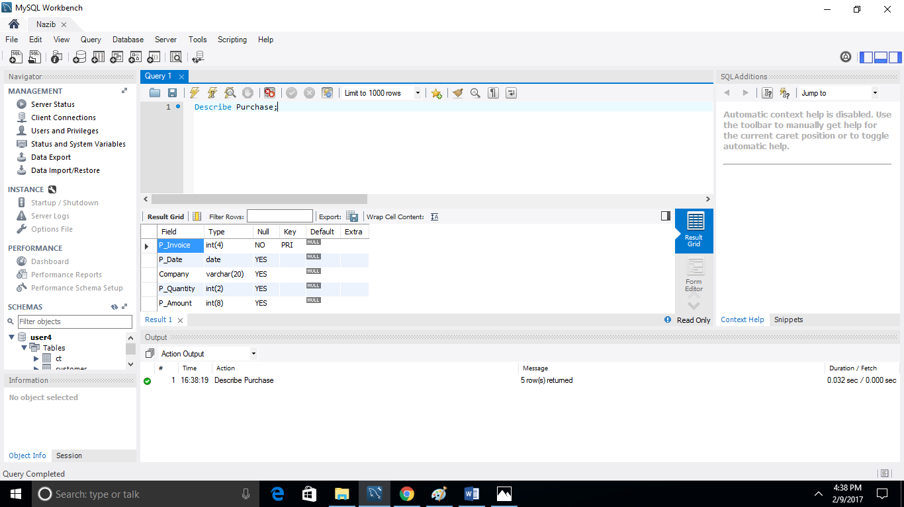
Viewing Table Structure

Slide 5
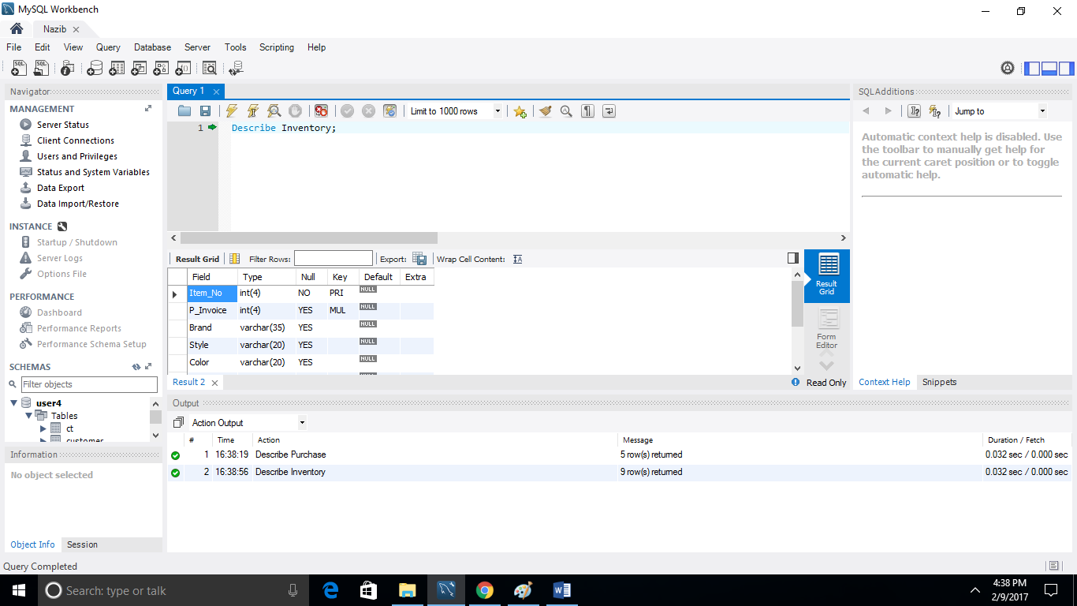
Viewing Table Structure

Slide 6
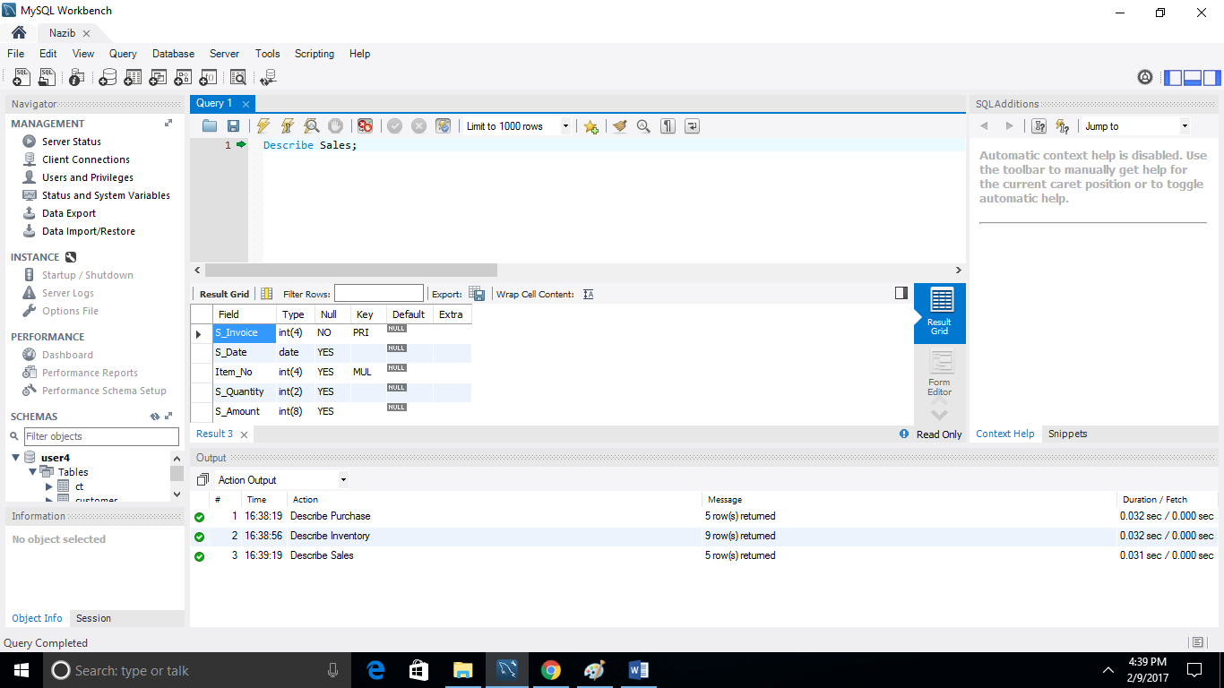
Viewing Table Structure

Slide 7
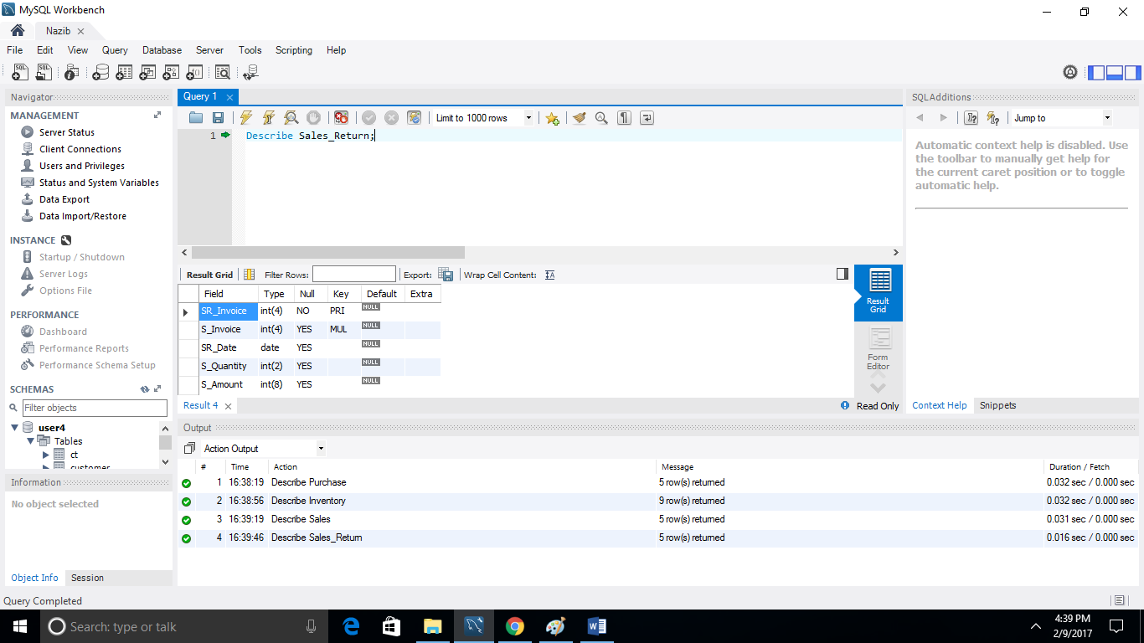
Viewing Table Structure

Slide 8
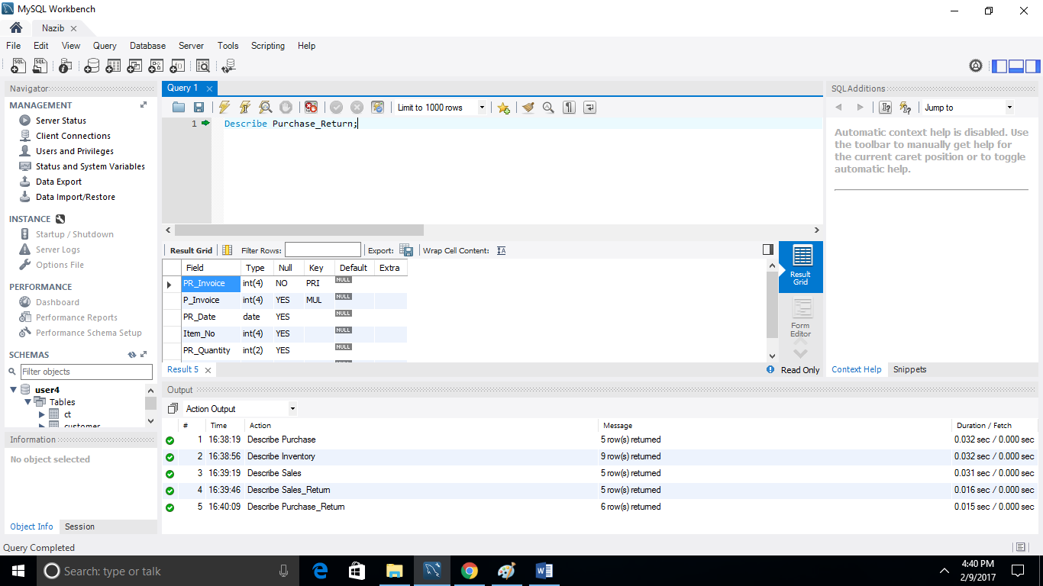
Viewing Table Structure

Slide 9
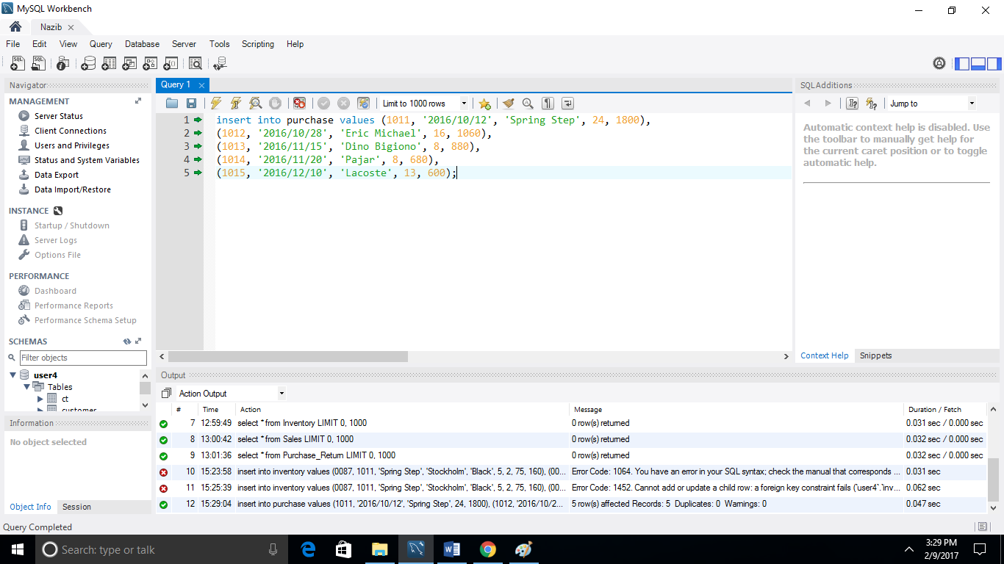
Inserting Values in Table

Slide 10
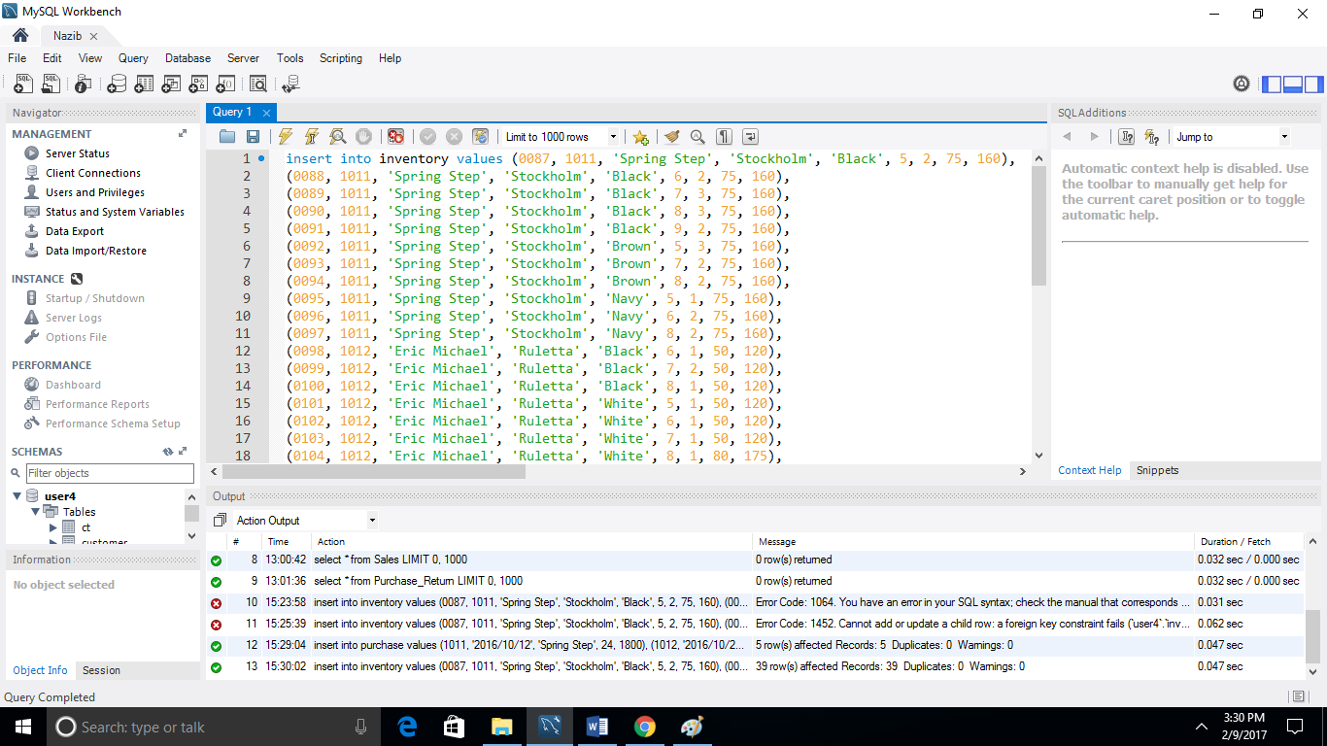
Inserting Values in Table

Slide 11
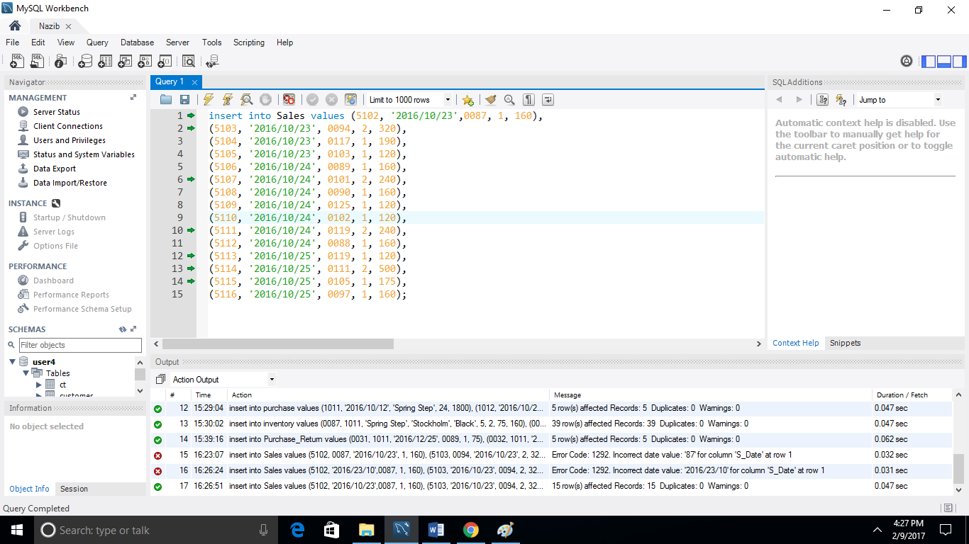
Inserting Values in Table

Slide 12
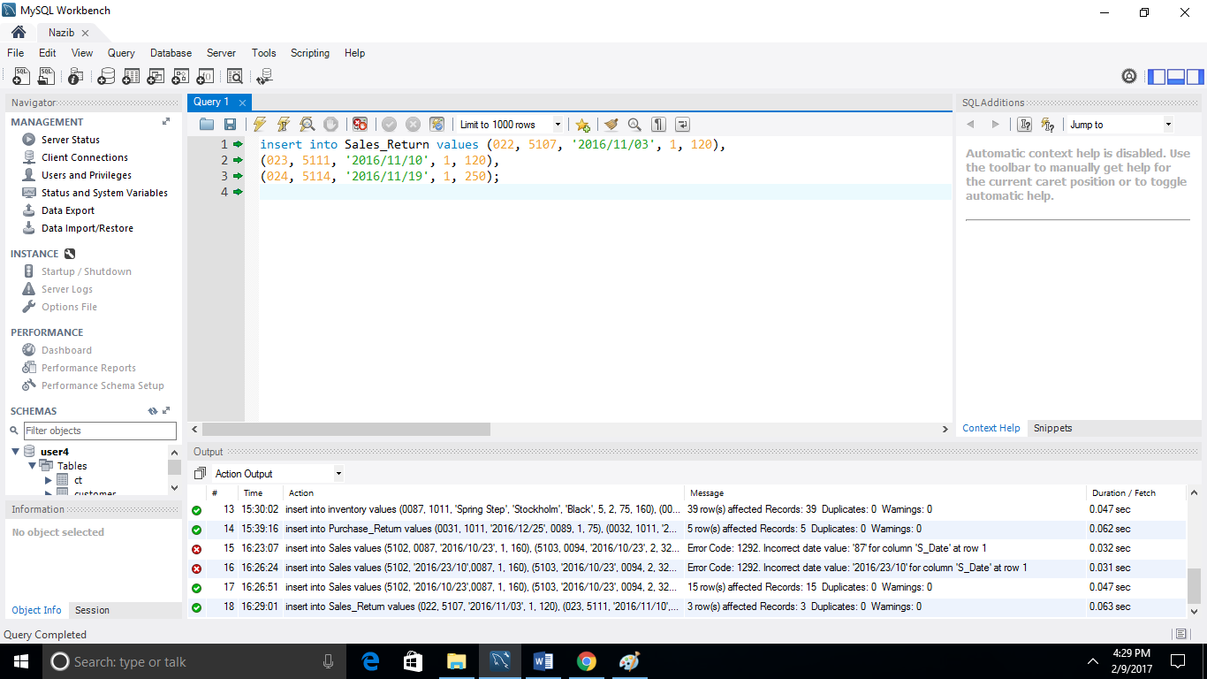
Inserting Values in Table

Slide 13
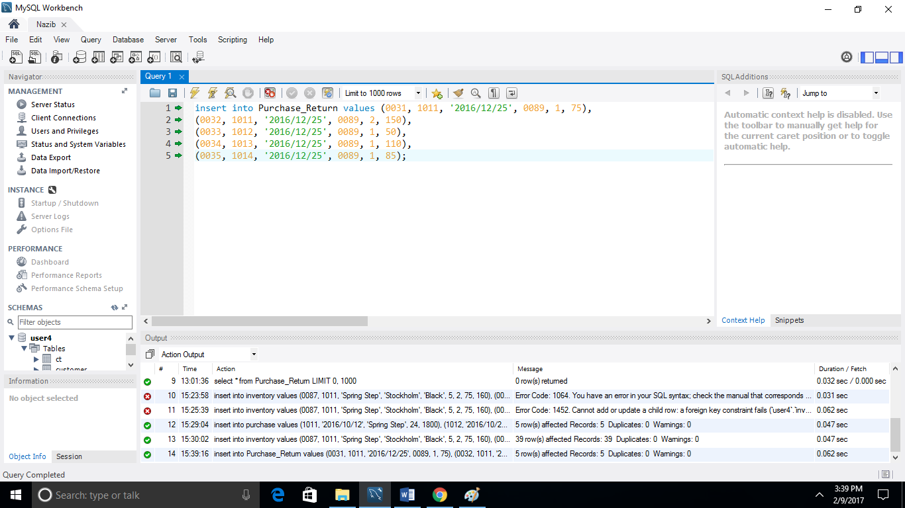
Inserting Values in Table

Slide 14
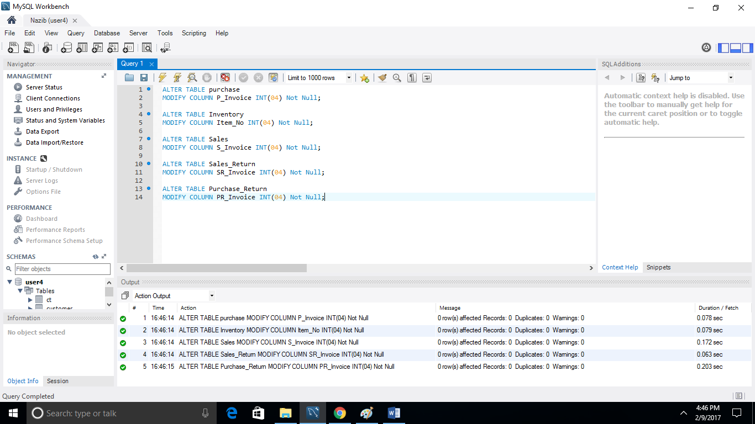
Altering Table to Modify Column

Slide 15
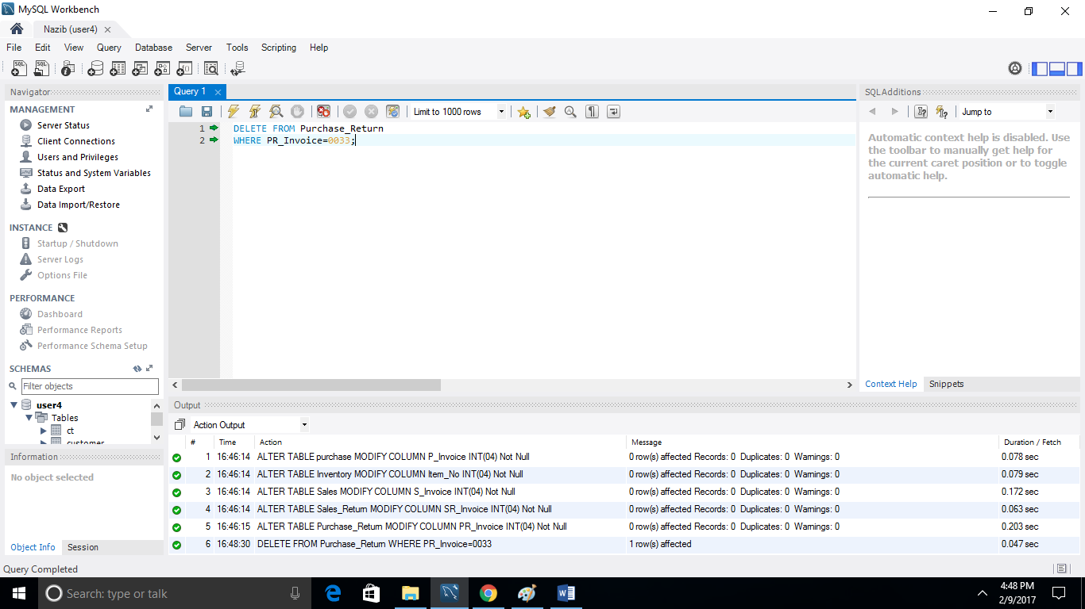
Deleting a Row from one of the Tables

Slide 16
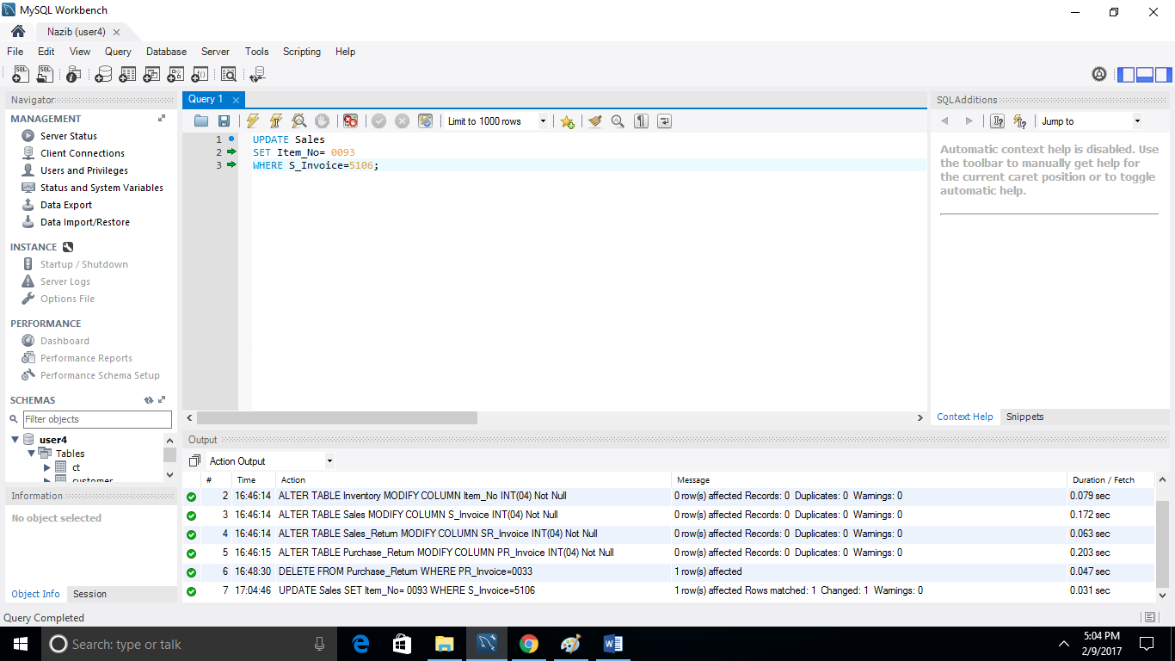
Updating Table to Change a Value

Slide 17
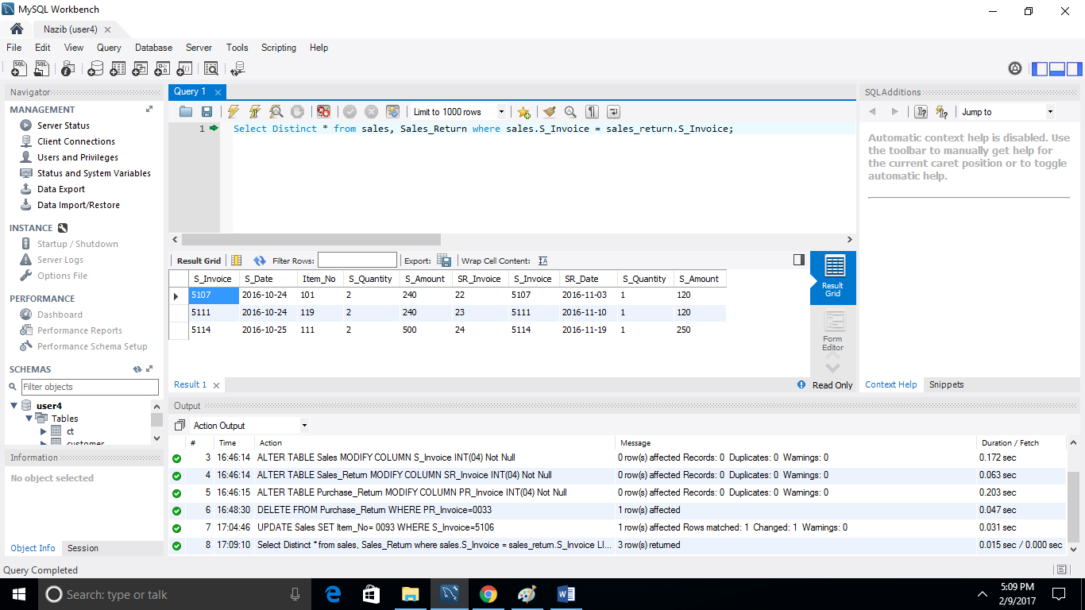
Viewing two Fields from Two Tables

Slide 18
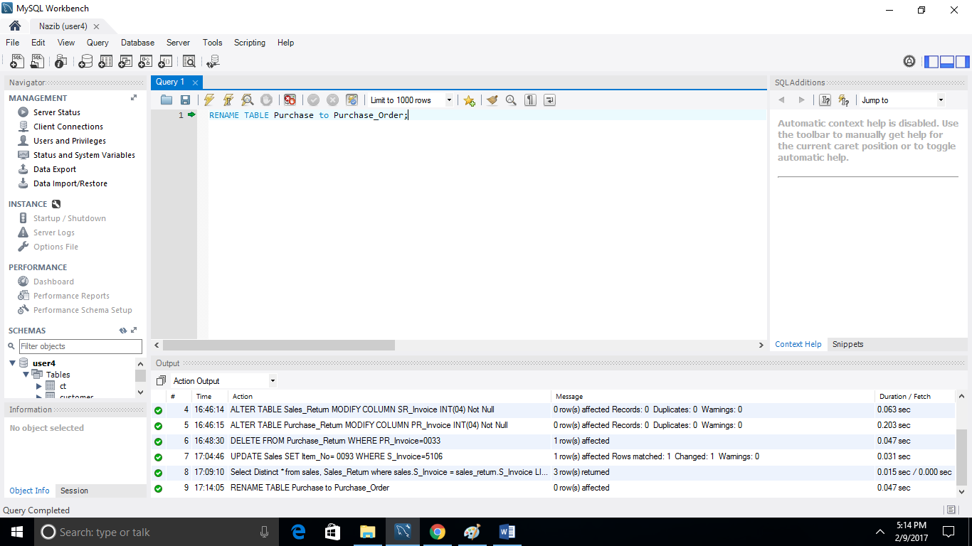
Renaming one of the Tables

Slide 19
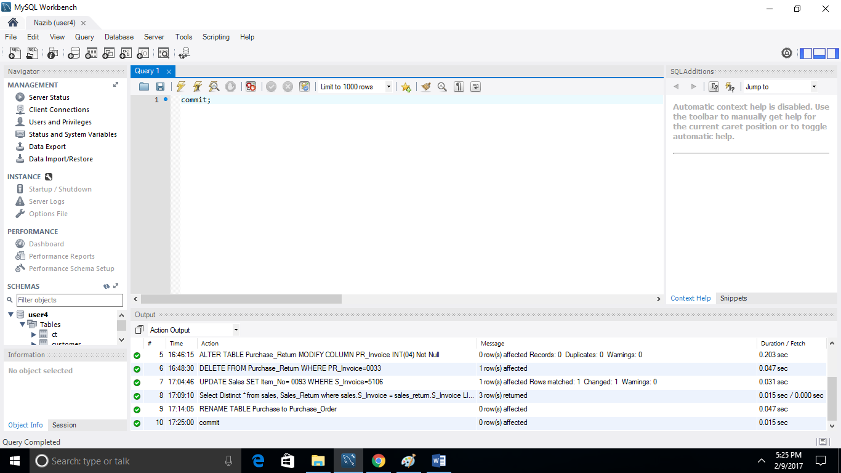
Saving Information from all Tables

Slide 20
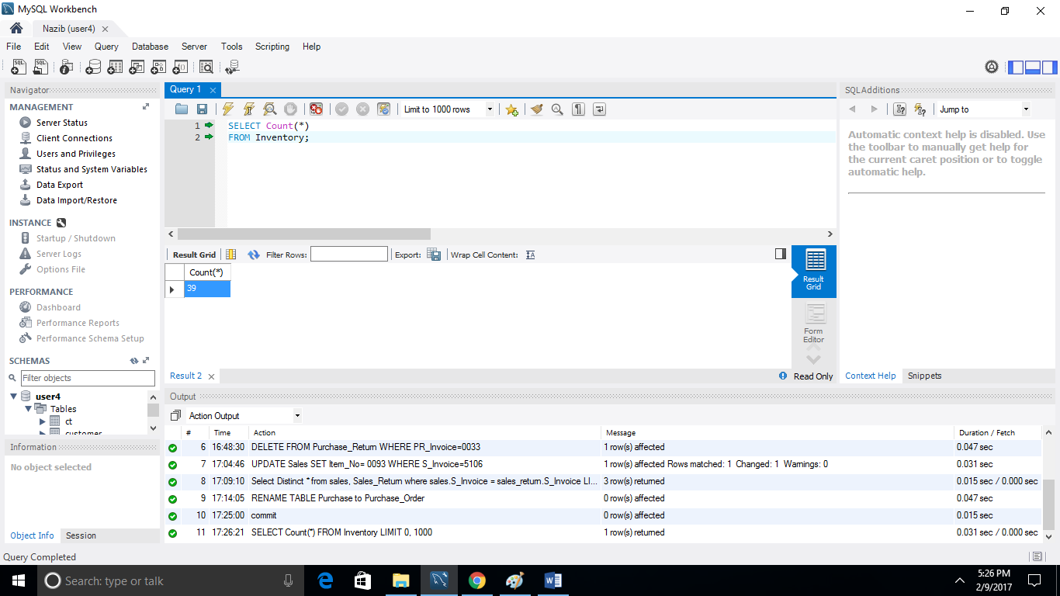
Counting Rows in one of the Table

Slide 21
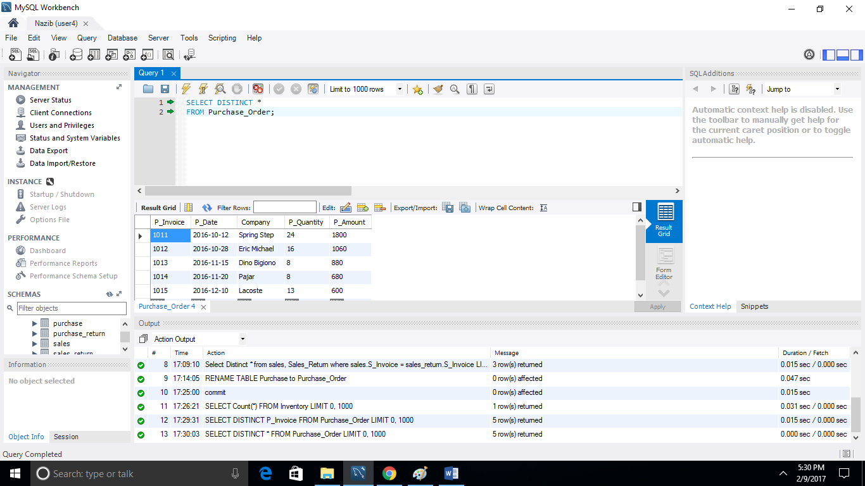
Viewing all Information with no Duplicates

Slide 22
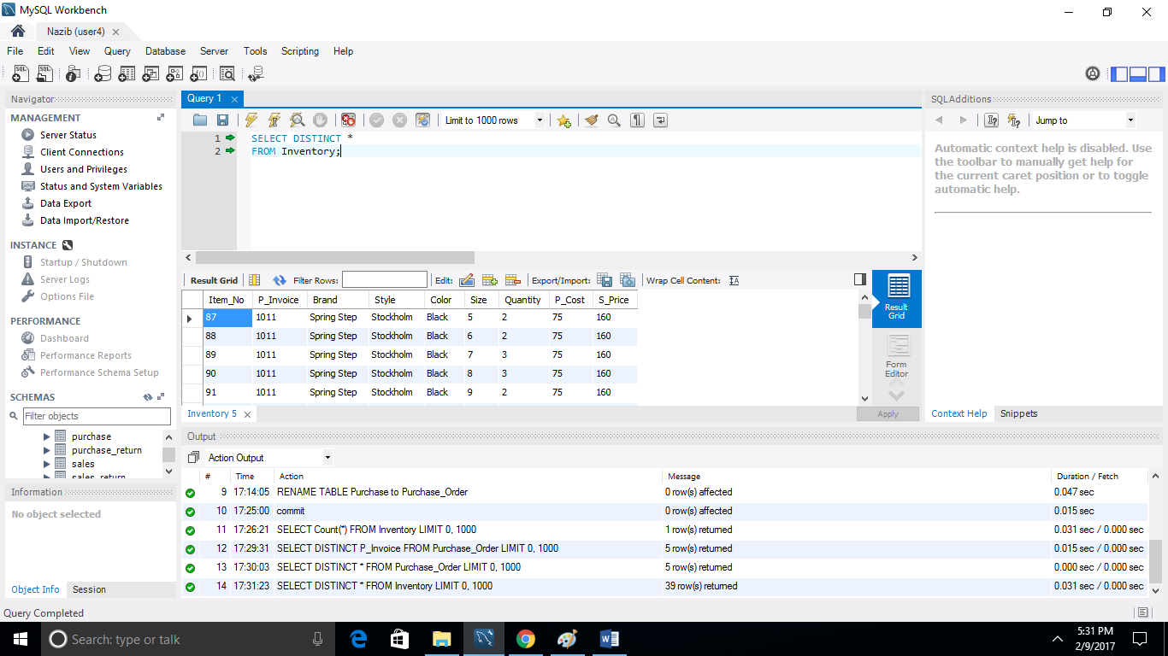
Viewing all Information with no Duplicates

Slide 23
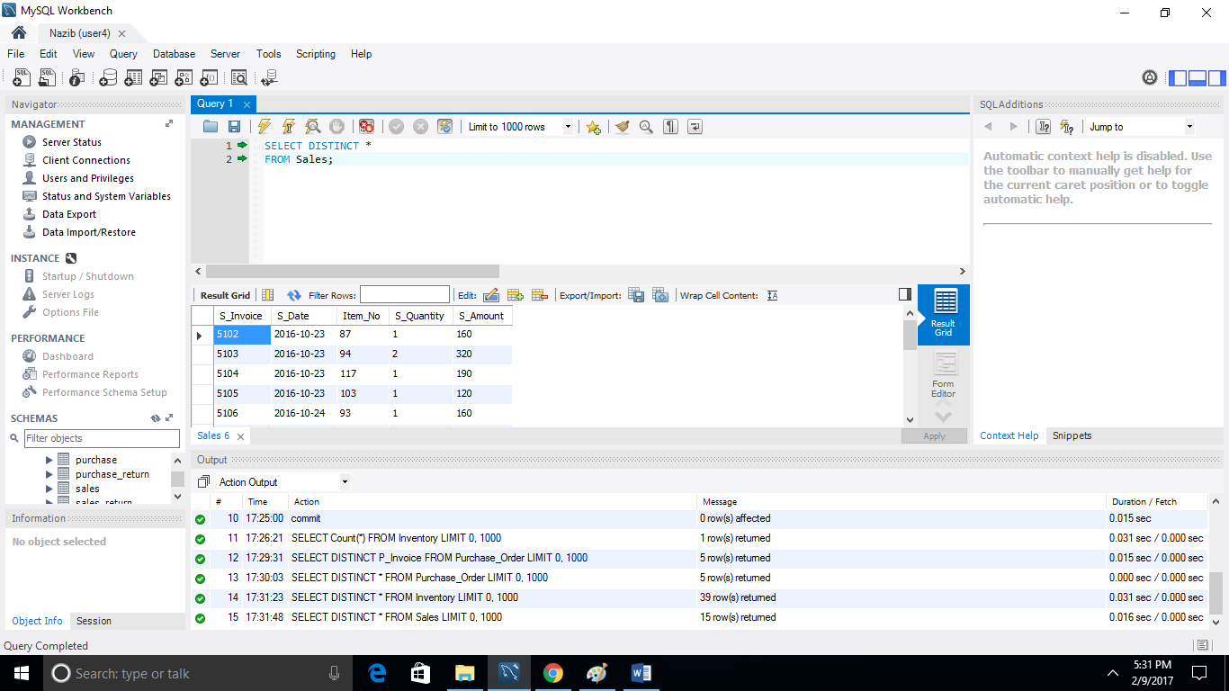
Viewing all Information with no Duplicates

Slide 24
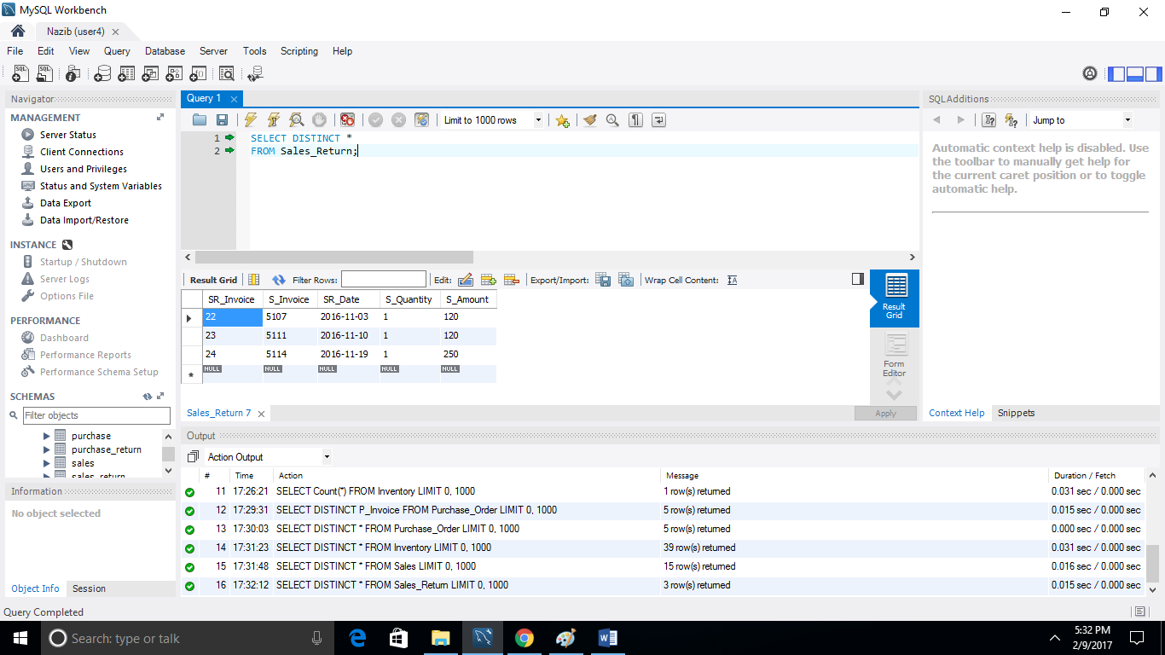
Viewing all Information with no Duplicates

Slide 25
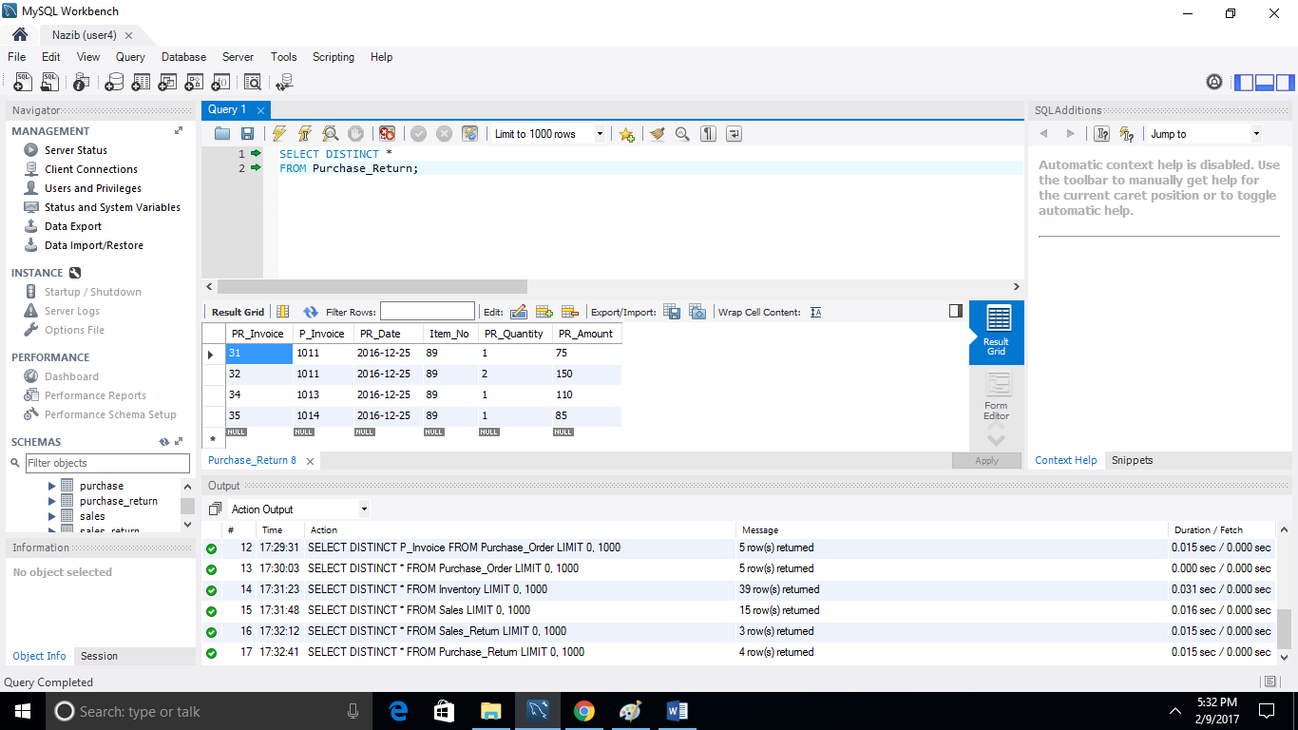
Viewing all Information with no Duplicates

Slide 26
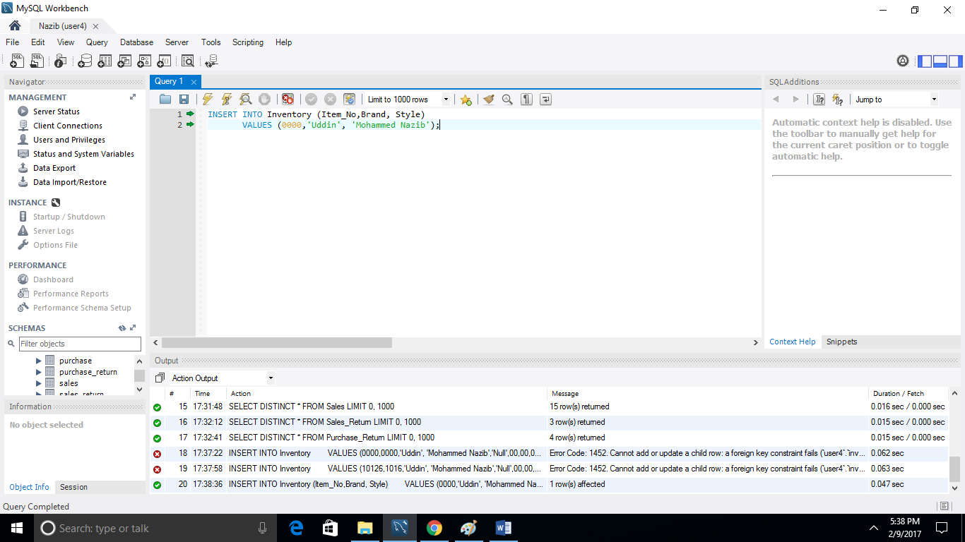
Adding a Row with my First and Last Name

Slide 27
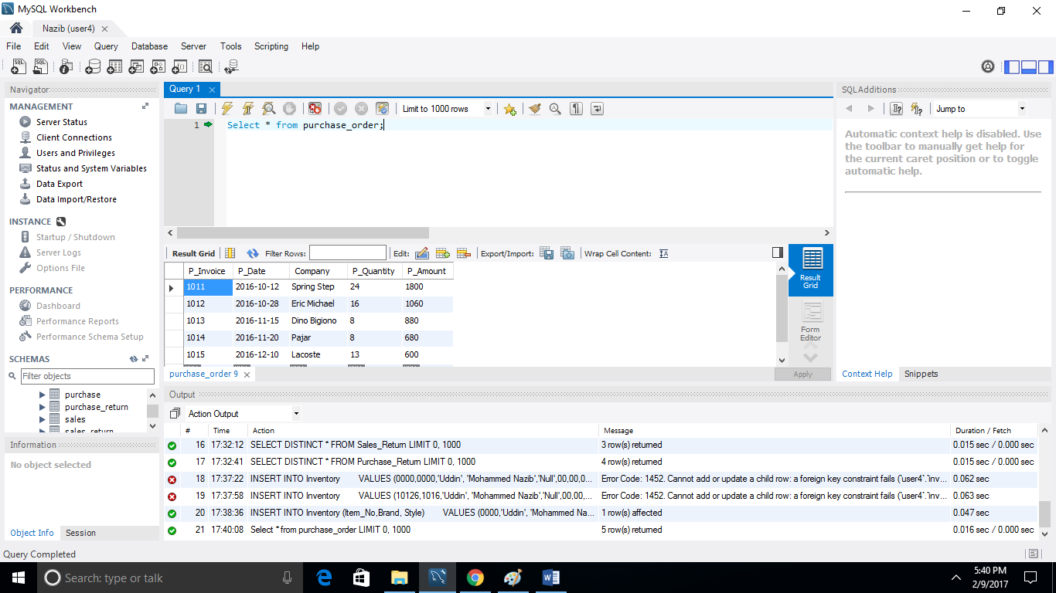
Viewing all the Changes made

Slide 28
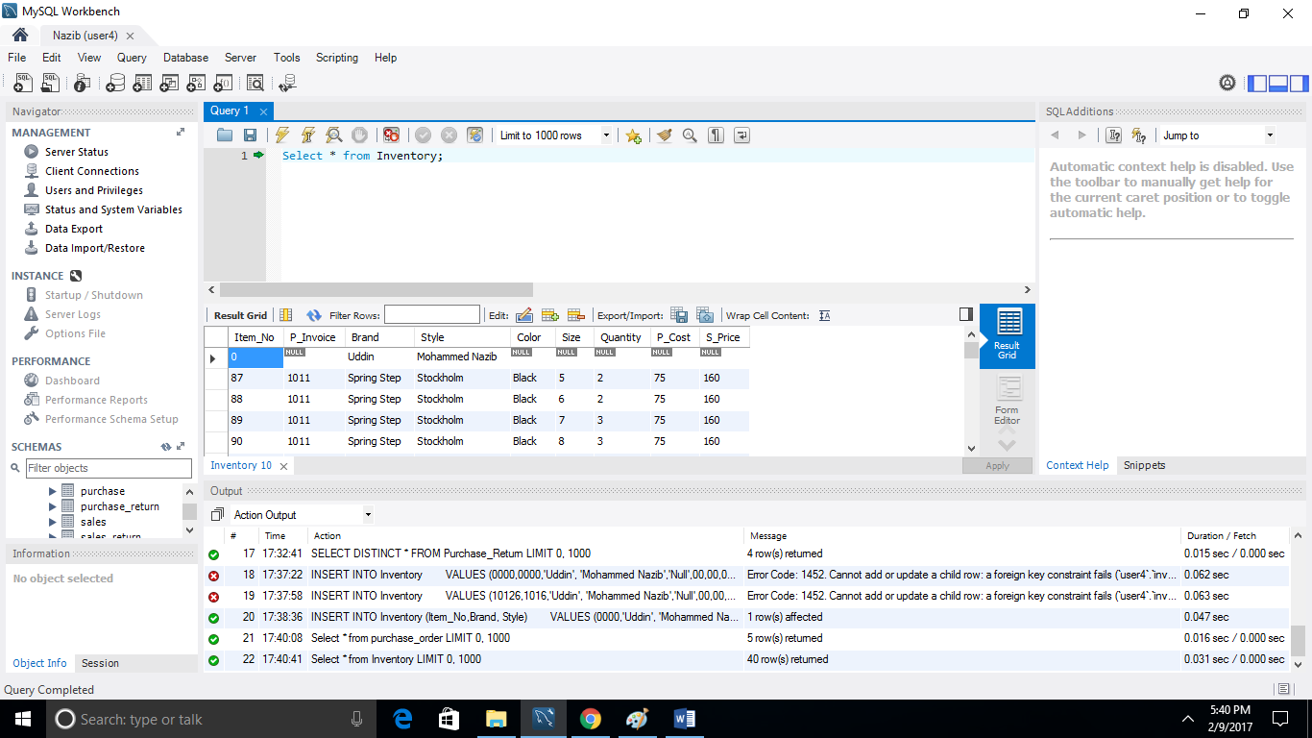
Viewing all the Changes made

Slide 29
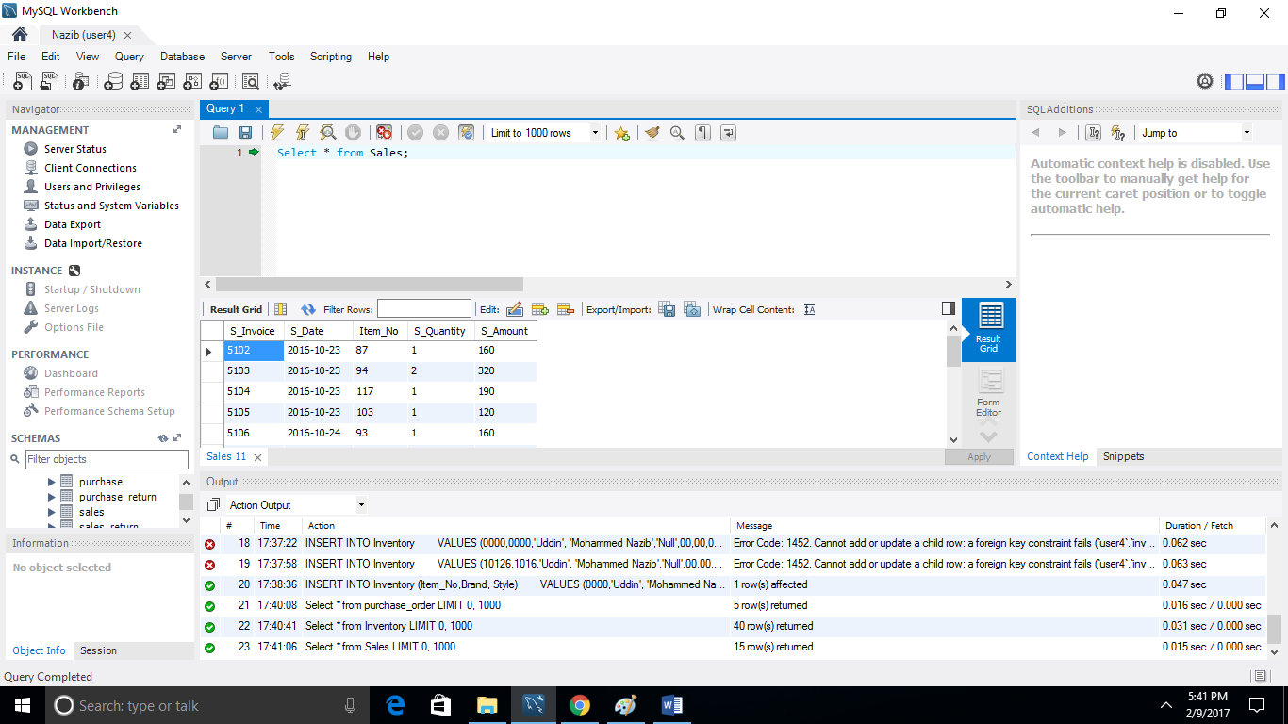
Viewing all the Changes made

Slide 30
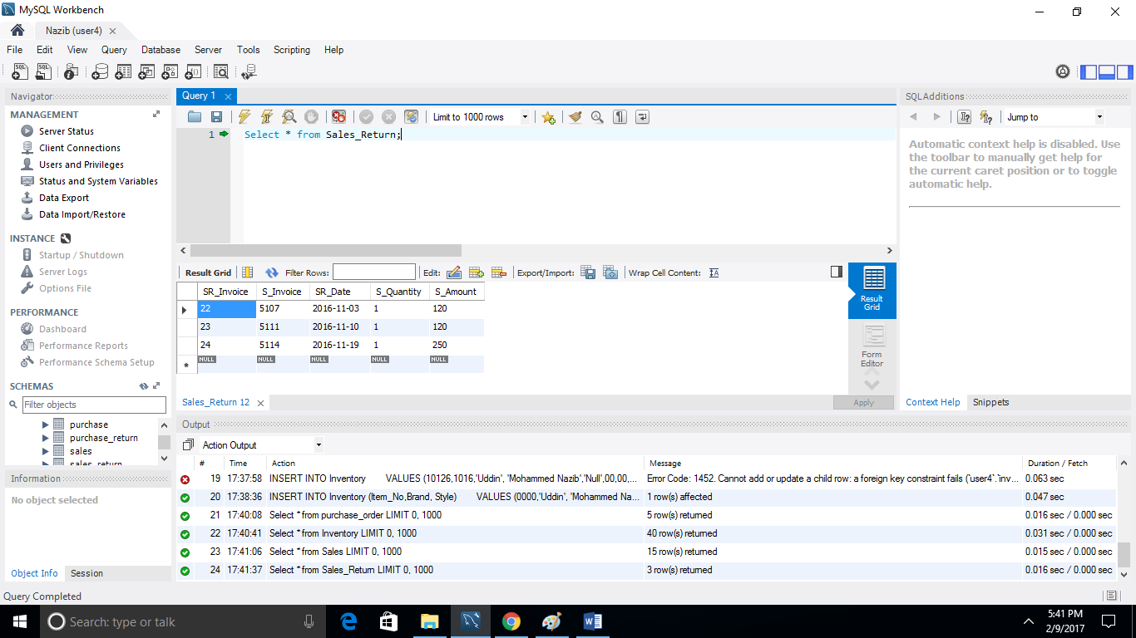
Viewing all the Changes made

Slide 31
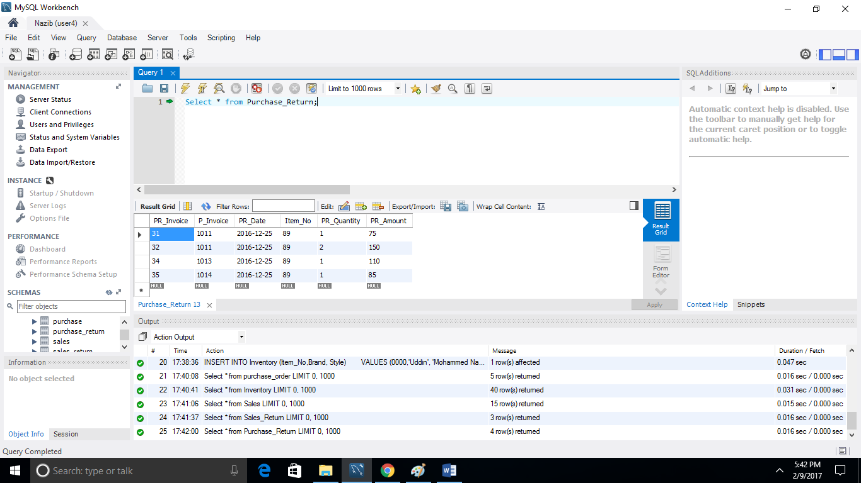
Viewing all the Changes made

Slide 32
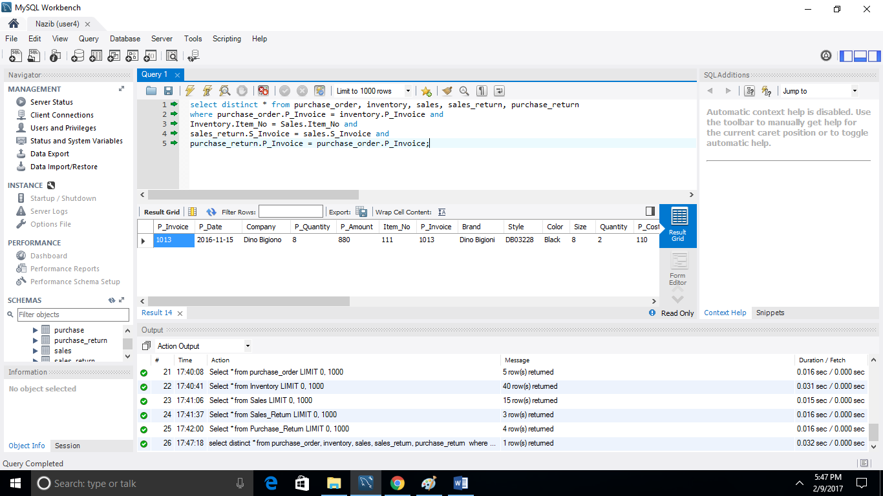
Joining all of the Tables and Selecting one Field from all

Slide 33
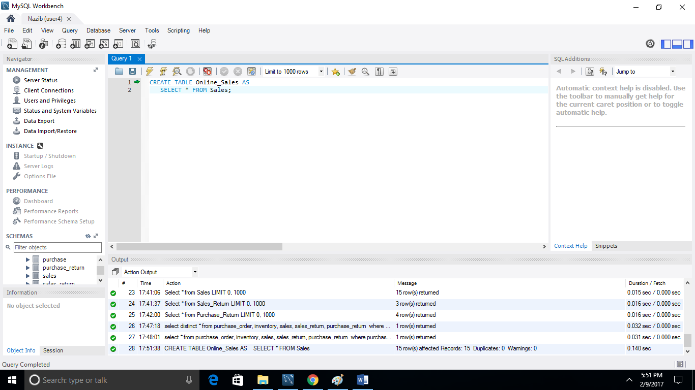
Creating new Table from an existing one

Slide 34
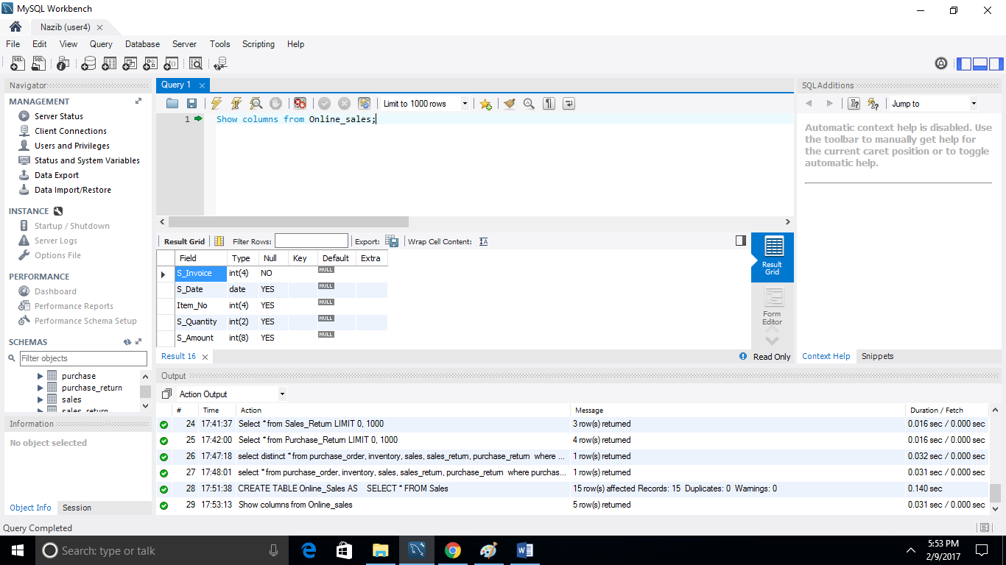
Viewing the new Table Structure

Slide 35
That’s it !

